Slide 1
ATM Controller
CS225/CS226 Project
by M Maheeth Reddy

Slide 2
Design
We use ATMs in our daily lives to perform various banking transactions. In this project, I have designed the ATM controller as a Mealy FSM.
To design the ATM controller, the entire operation of an ATM, has been divided into four steps:
A/c number Identification
Banking Services
Transactions
PIN
Verification

Slide 3
Account Number Identification
Stage 1
In this project, I have assumed that a bank account has the following structure:
In a real-life ATM, a user can access their account by swiping an ATM Card. The controller uses the account number to retrieve account details from the bank’s database.
If the account number is valid it proceeds to the next stage, otherwise it goes into an error state and then come back to stage 1.
Account Number | 5-bit
Personal Identification Number (PIN) | 4-bit
Account Balance | 6-bit
Account State | 1-bit

Slide 4
PIN Verification
Stage 2
Enter PIN
Attempt 1
PIN is used to authenticate the user.
If the PIN entered by user matches the PIN stored in the account details, it proceeds to the Banking Services section.
Else, it prompts the user to re-enter the pin for a maximum of 2 more attempts.
If the user fails to enter the correct pin in the 3 attempts given, the account is blocked and the status bit in the account details is changed to 0 and the user is refrained from making any further transactions through that account.
Valid
Invalid
Banking Services
Enter PIN
Attempt 2
Valid
Invalid
Enter PIN
Attempt 3
Invalid
Account Blocked
Account Number Identification

Slide 5
Select Banking Services
Stage 3
There are 4 services available in the ATM machine. User can select their desired service through the ATM, which is encoded and communicated to the controller as shown below:
Service | Display Balance | Changing PIN | Money Withdrawal | Money Deposit
Encoded Value | 00 | 01 | 10 | 11

Slide 6
Display Balance
Stage 4
Select Banking Service
When the controller receives input 00 from stage 3, account balance is displayed.
Now the ATM controller goes back to Card Identification state. The ATM can be used another time.
Input 00
Display Balance
Success State
Account Number Identification

Slide 7
Change PIN
Stage 4
Select Banking Service
Input 01
Pin Change
Enter new PIN
When the controller receives input 01 from stage 3, the user is asked to enter a new PIN.
Once the new PIN is entered, the user is asked to re-enter the new PIN.
If both values match, the PIN gets updated in the account details and the ATM controller goes back to Card Identification state.
If the both values don’t match, then the user is asked to enter the new PIN again.
This process gets repeated till both the values entered by the user match.
If same PIN is
not retyped
Confirm New PIN
If same PIN
is retyped
Success State
Account Number Identification

Slide 8
Cash Withdrawal
Select Banking Service
Stage 4
Input 10
Cash Withdrawal
Enter Amount
When the controller receives input 10 from stage 3, user is allowed to enter amount of cash to be withdrawn.
If the amount entered is less than the balance available, then the amount gets deducted from the balance, the final balance is displayed and ATM controller goes into a success state and then back to Card Identification state.
If the amount entered is greater than the balance available, then the controller goes into an error state indicating the transaction is declined. Then ATM controller goes back to Card Identification state.
If Amount ≤ Balance
If Amount > Balance
Display New Balance
Error State
Success State
Account Number Identification

Slide 9
Cash Deposit
Select Banking Service
Stage 4
Input 11
Cash Deposit
Give Cash
When the controller receives 11 as input from stage 3, user is allowed to deposit cash.
User places cash in the cash tray. ATM machine counts the denominations and calculates the amount inserted. The controller stores this value and asks the user for confirmation.
If the user confirms, the amount is deposited in the user’s account. The balance will be updated. Then ATM Controller goes back to Card Identification state.
Otherwise, the cash is returned and balance doesn’t change. Then ATM Controller goes into an error state, then goes back to Card Identification state.
Yes
Confirm Denomination
Display New Balance
No
Error State
Success State
Account Number Identification

Slide 10
State Diagram
/00
11
0/10
3
1/01
/00
5
0
0/10
Mealy FSM
0/10
1/01
1
0/10
2
0 | Account Number Identification
1 | Enter PIN – First Attempt
2 | Enter PIN – Second Attempt
3 | Enter PIN – Third Attempt
4 | Select Banking Service
5 | Error State
6 | PIN Change – Enter New PIN
7 | Cash Withdrawal – Enter Amount
8 | Cash Deposit – Give Cash
9 | PIN Change – Confirm New PIN
10 | Cash Deposit – Confirm Cash
11 | Account Locked
12 | Success State
12
/00
1/01
1/01
4
00/01
01/01
11/01
10/01
6
7
8
0/01
0/10
9
0/10
/01
1/01
1/01
1/01
10
0/10

Slide 11
Demonstration
Design implemented in Verilog HDL

Slide 12
Demonstration
Consider a person who wants to perform the following tasks at the ATM:
Check account balance
Draw some money
Change PIN for his account
Deposit some money
Account Details
Account number | 00001
PIN | 0001
Balance | 010100 (20)
State | 1 (Active)

Slide 13
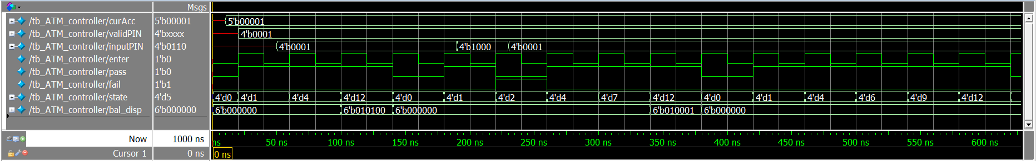
Card Identification
The ATM controller is in state 0.
When he swipes his ATM card, his bank account number (00001) is sent to the controller.
The controller goes to state 1, as shown in waveform.
0
1/01
1
Output variables

Slide 14
PIN Authentication
The ATM controller is in state 1. It prompts the person to enter the PIN. He enters 0001.
Since the entered PIN is valid, authentication is successful.
The ATM controller goes to state 4.
Valid PIN
Entered PIN
1
1/01
4
State change from 1 to 4

Slide 15
Checking Balance
State change from 1 to 4
ATM controller is in state 4. It prompts the user to choose a banking service.
He opts to check his balance.
Controller goes to state 12/Success State
And balance is displayed
4
00/01
12
Display Balance
Display Balance

Slide 16
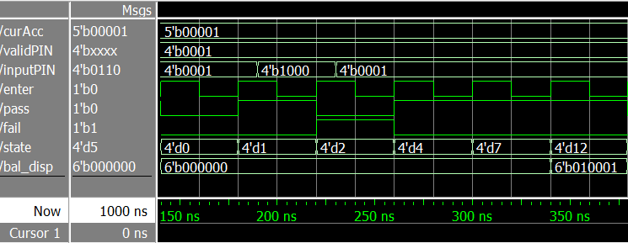
Cash Withdrawal
 | Binary | Decimal
Old Balance | 010100 | 20
Cash Withdrawn | 000101 | 3
New Balance | 010001 | 17
Valid PIN
Entered PIN
Attempt 1
Entered PIN
Attempt 2
1
0/10
2
1/01
4
10/01
7
1/01
12
State change from 1 to 2
State change from 4 to 7
Display New Balance
State change from 2 to 4

Slide 17
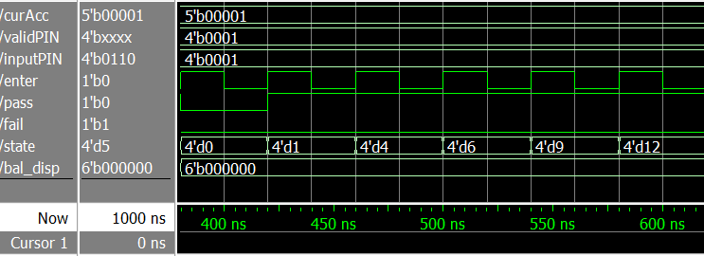
Change PIN
New PIN is entered : 0110
New PIN is confirmed
4
01/01
6
0/10
0/01
9
1/01
PIN Change successful
12

Slide 18
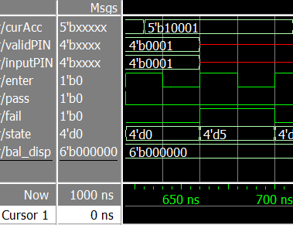
Card Identification
Account number not in bank’s database
Card Identification failed
Controller goes into State 5/Error State
0/10
0
5
/00

Slide 19
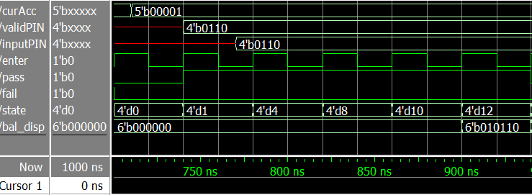
Cash Deposit
 | Binary | Decimal
Old Balance | 010001 | 17
Cash Deposit | 000101 | 5
New Balance | 010110 | 22
Cash Deposit option is chosen
Cash deposit is confirmed
4
11/01
8
/01
12
10
1/01
Display New Balance

Slide 20
Conclusion
Working on this project has helped understanding the concept of Finite State Machine and designing the architecture of a system.

Slide 21
Acknowledgements
The research paper mentioned below has been my inspiration for this project:
An ASIC Implementation of Automated Teller Machine Controller for Secured Financial Transactions
PONNA. DIVYA , AMMIREDDY LAVANYA, TADI. CHANDRA SEKHAR
http://www.ijvdcs.org/uploads/614235IJVDCS600-17.pdf

Slide 22
Thank You

